Slide 1
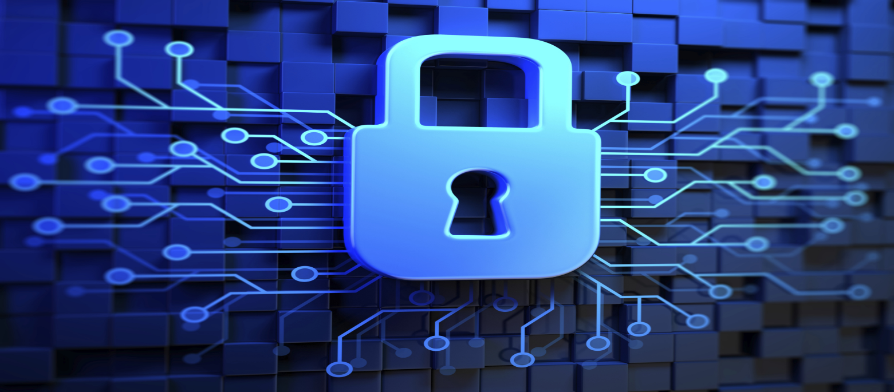
Information Security Engr. Syed Rizwan

Slide 2
Course: Information Security
Text book
None
Reference books
CompTIA Security + Guide to Network Security Fundamentals by Mark Ciampa Seventh Edition
Principles of Information Security by Michael E. Whitman and Herbert J. Mattord

Slide 3

WhatsApp Group

Slide 4
Course Aims/Objectives
In this course students learn basics of information security, in both management aspect and technical aspect.
Students understand of various types of security incidents and attacks, and learn methods to prevent, detect and react incidents and attacks.
Students will also learn basics of application of cryptography which are one of the key technology to implement security functions.

Slide 5
Learning Outcomes
To become able to explain various Information security threat and controls for it.
To become able to analyze a security incidents and design countermeasures.
To become able to explain information security incident response.
To become able to explain the usage of Common Key cryptography and Public Key cryptography.
To become able to explain the mechanism to protect confidentiality and completeness of data.

Slide 6
Requirements
Basic Requirements
Read materials before/after class.
Work on your homework individually.
Discussions are encouraged but don’t copy others’ work.
Get you hands dirty!
Experiment with ideas presented in class and gain first-hand knowledge!
Come to class and DON’T hesitate to speak if you have any questions/comments/suggestions!
Student participation is important!

Slide 7
Content to be covered
The meaning of computer Security
Importance
Data Security Goals

Slide 8
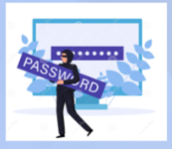

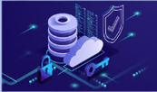

The core content of this course comprises of the following 4 modules:
Module I→ The security problem in computing
Module II → Program security
Module III → Database Security
Module IV → Administering Security

Slide 9
The meaning of computer security
The meaning of the term computer security has evolved in recent years. Before the problem of data security became widely publicized in the media, most people's idea of computer security focused on the physical machine. Traditionally, computer facilities have been physically protected for three reasons:
To prevent theft of or damage to the hardware
To prevent theft of or damage to the information
To prevent disruption of service

Slide 10
Importance
Computer security is security applied to computing devices such as computers and smartphones, as well as computer networks such as private and public networks, including the whole Internet.
The field covers all the processes and mechanisms by which digital equipment, information and services are protected from unintended or unauthorized access, change or destruction, and are of growing importance in line with the increasing reliance on computer systems of most societies worldwide.
It includes physical security to prevent theft of equipment, and information security to protect the data on that equipment.

Slide 11
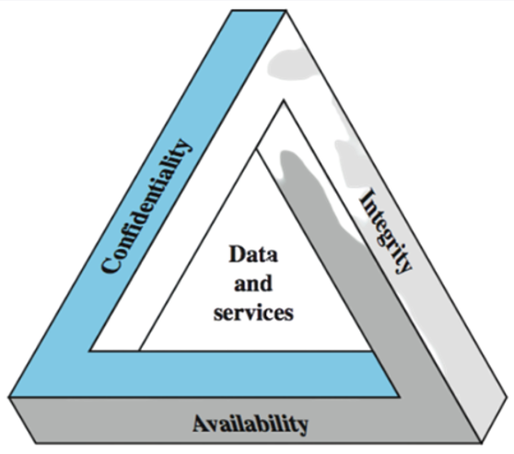
Data Security Goals
Data security goals are three-fold.
It is known as CIA triad

Slide 12
Data Security Goals
Confidentiality
the assurance that the access to information is authorized
Integrity
the assurance that the information is trustworthy and accurate
Availability
is a guarantee of reliable access to information by authorized people when needed

Slide 13
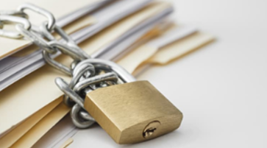
Confidentiality
Confidentiality is roughly equivalent to privacy.
Data encryption is a common method of ensuring confidentiality.
User IDs and passwords, two-factor authentication, biometric verification, OTP, security tokens etc. are common examples of achieving confidentiality.
Extra measures might be disconnected storage devices or, for highly sensitive information, in hard copy form only.

Slide 14
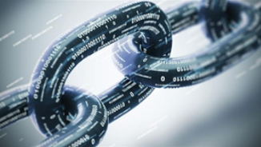
Integrity
Integrity involves maintaining the consistency, accuracy and trustworthiness of data.
Data must not be changed in transit.
Version control may be used to prevent erroneous changes or accidental deletion by authorized users.
Backups or redundancies must be available to restore the affected data to its correct state.

Slide 15
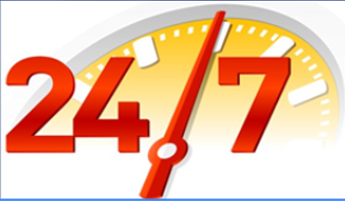
Availability
Availability is best ensured by keeping all necessary system upgrades all the time.
Providing adequate communication bandwidth and preventing the bottlenecks.
Redundancy, failover, RAID can mitigate serious consequences.
Comprehensive disaster recovery plan (DRP).
Safeguards against natural disasters and fire. A backup copy may be stored in a geographically-isolated location, perhaps even in a fireproof, waterproof safe.
Extra security such as firewalls and proxy servers can guard against down time and unreachable data due to denial-of-service (DoS) attacks and network intrusions.

Slide 16
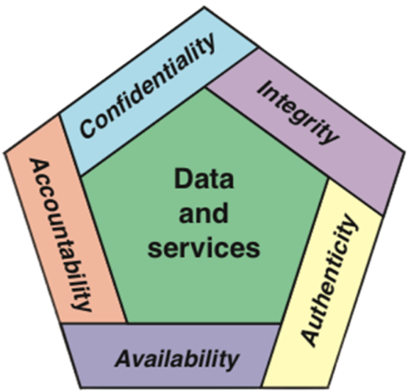
CIAAA (5 Principles of Security)

Slide 17
Authenticity
Verifying that users are who they say they are and that each input arriving at the system came from a trusted source
Accountability
The security goal that generates the requirements for action of an entity to be traced uniquely to that entity

Slide 18
Questions ?

